Slide 1
















Slide 2
















Slide 3
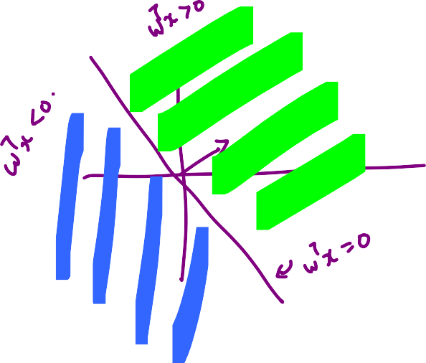
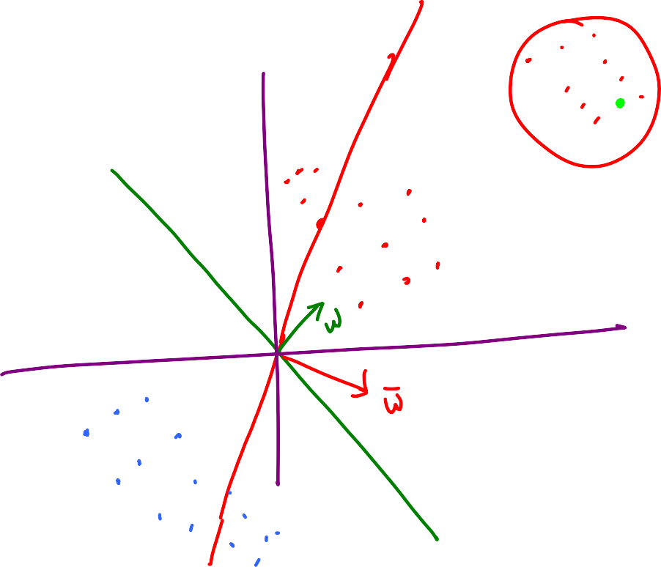




Slide 4











Slide 5















Slide 6
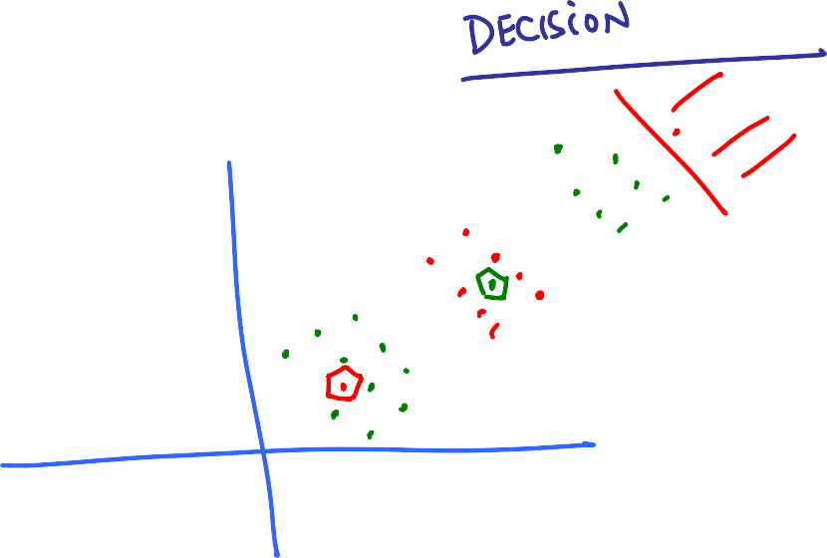


Slide 7
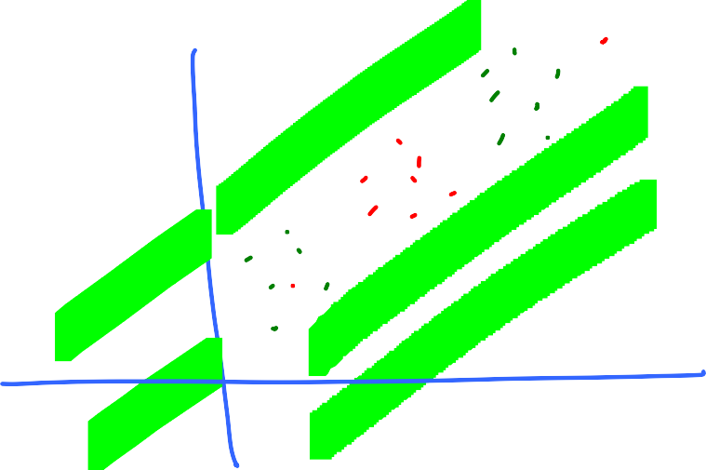





Slide 8

















Slide 9











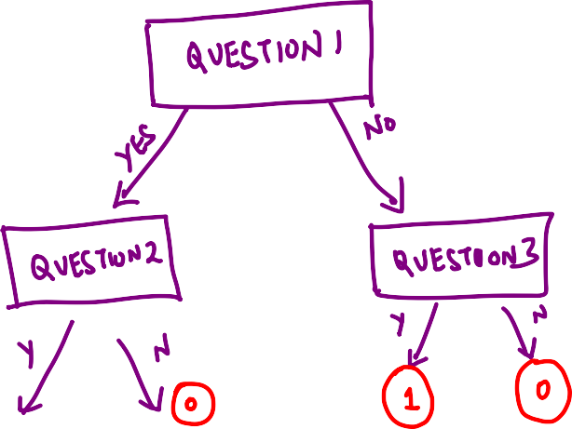



Slide 10

















Slide 11















Slide 12



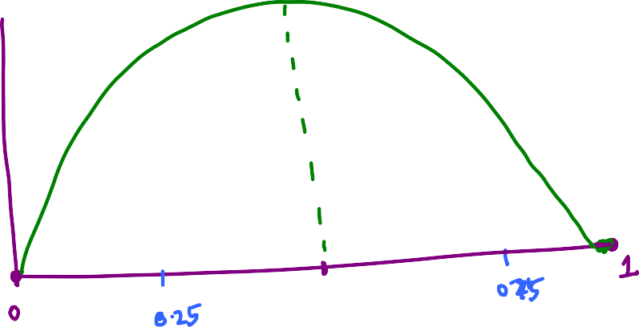











Slide 13




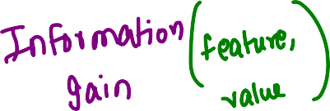




2

Slide 14





















Slide 15
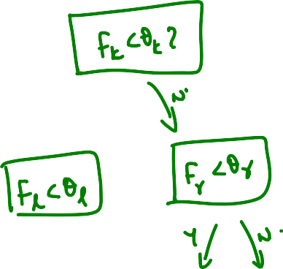
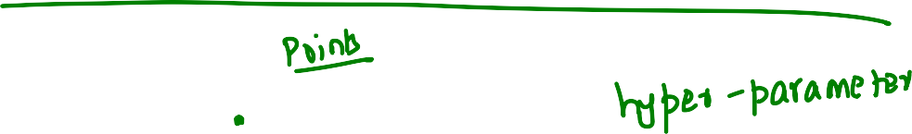











Slide 16
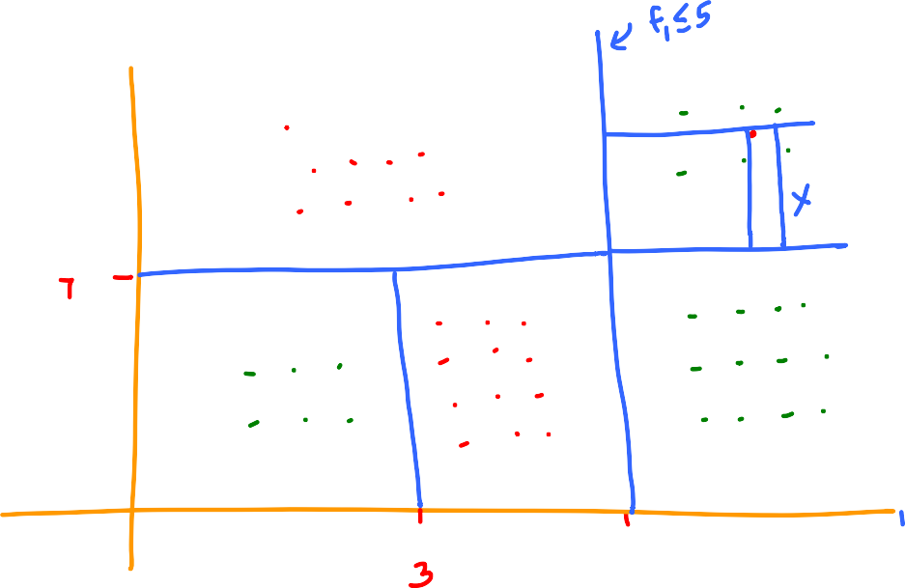

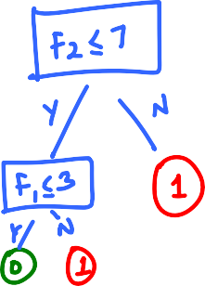



Decision Boundary

Slide 18
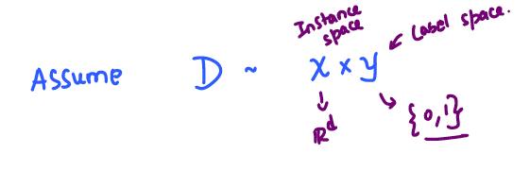
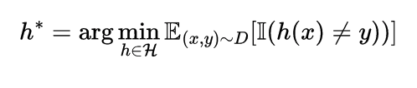
Formal Treatment of the Learning Problem
Both training and test data are drawn from the same distribution!
If one is given access to D, what is the best classifier?
In words, h* is the classifier that minimizes the average test error

Slide 19

Formal Treatment of the Learning Problem
Expectation of a indicator function is probability. So,

Slide 20
P(x) is Uniform over {x1,x2,x3,x4,x5}
Data points
Prob of y/x = -1
Prob of y/x = 1
x2
x1
x5
A typical dataset
from this distribution
x3
x5 | 1
x3 | -1
x2 | 1
x4 | 1
x3 | -1
x1 | 1
x4

Slide 21
Prob of y/x = -1
Prob of y/x = 1
A sub-optimal classifier

Slide 22
Prob of y/x = -1
Prob of y/x = 1
Optimal classifier – Gives 0 test error!!

Slide 23
What if there is no classifier can make zero error?
P(x) is Uniform over {x1,x2,x3,x4,x5}
x2
x1
x5
A typical dataset
from this distribution
x5 | 1
x3 | -1
x2 | 1
x4 | 1
x2 | -1
x4 | -1
x3
x4

Slide 24
Is this classifier
optimal?
Error =
+
+
+

Slide 25
How should the “best” classifier predict?

Slide 26
Error =
+
+

Slide 27
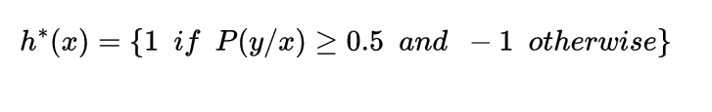
Formal Treatment of the Learning Problem
Expectation of a indicator function is probability. So,
BAYES OPTIMAL CLASSIFIER

Slide 28
GOOD NEWS
We know the form of the best classifier
BAD NEWS
We don’t know the distribution D over X,Y

Slide 29
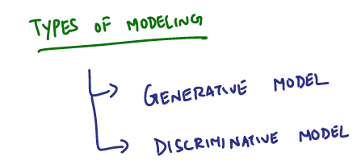
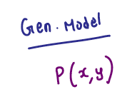
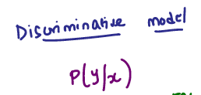
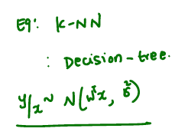
We will make assumptions about distribution generating data
Note that in both models, we only need P(y/x)
to make predictions

Slide 30
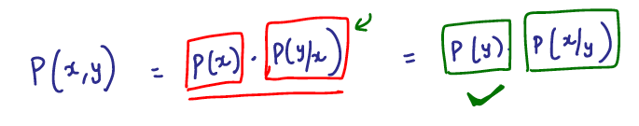
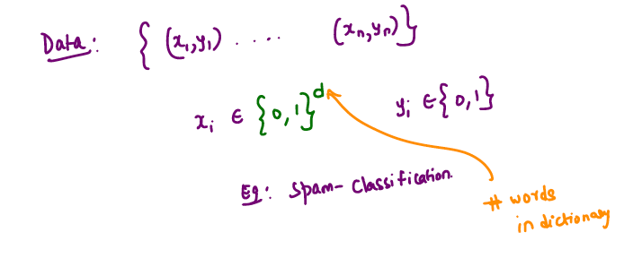
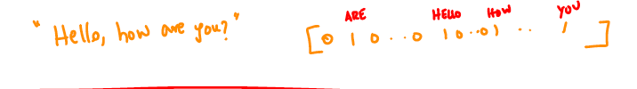
Generative Models

Slide 31
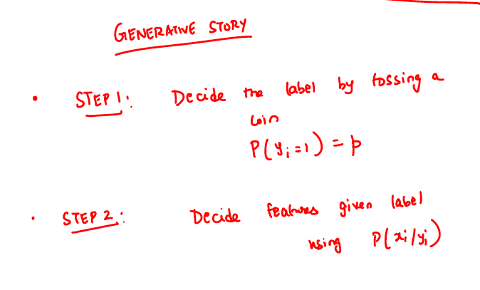

Slide 32
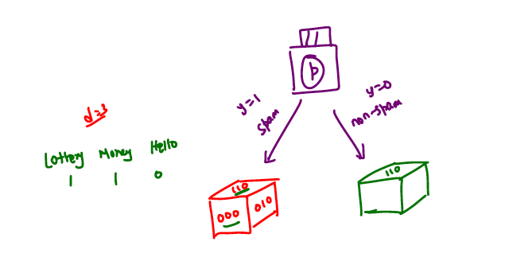
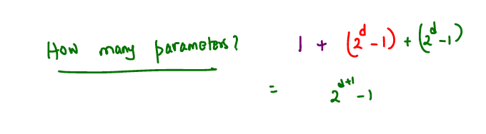
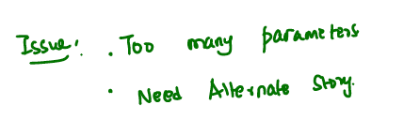

Slide 33
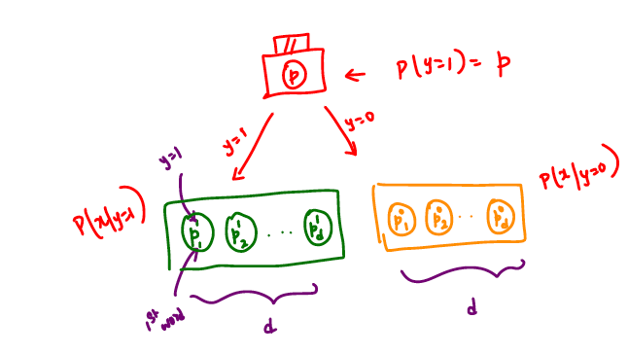
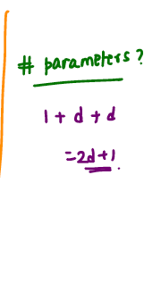

Slide 34
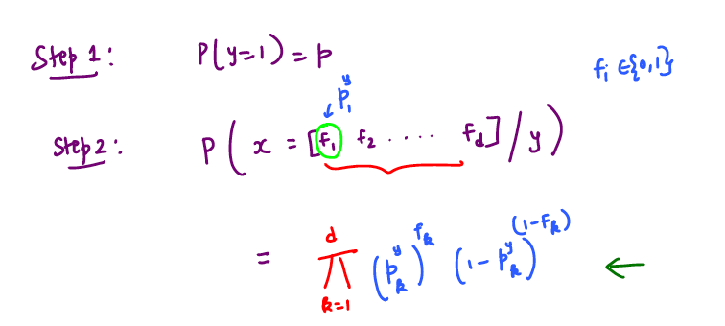
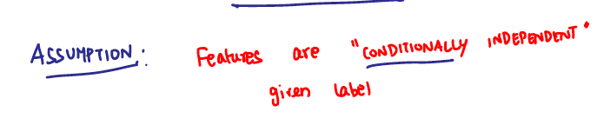

Slide 35
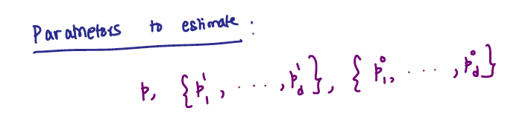
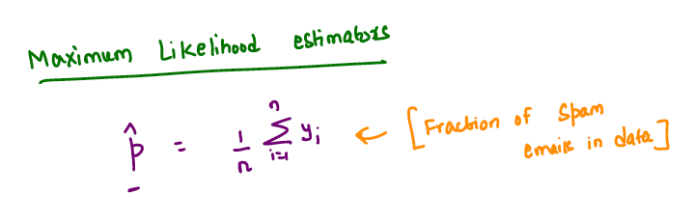
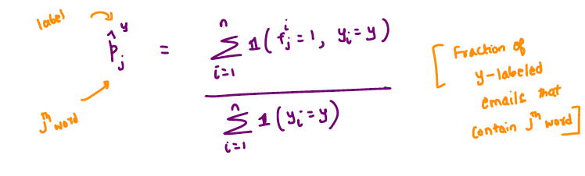

Slide 36
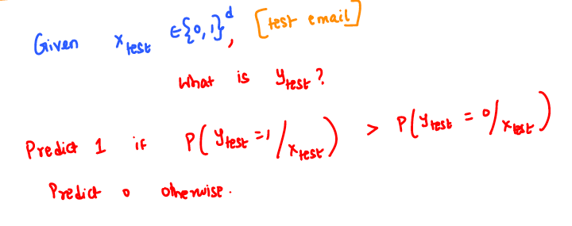
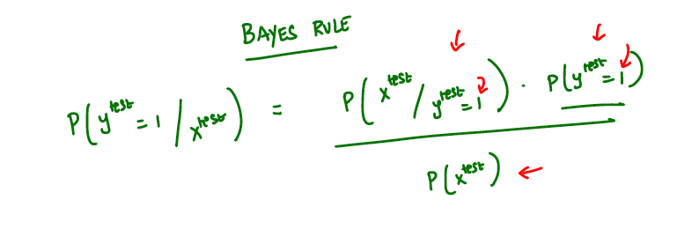

Slide 37
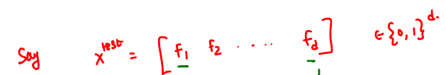
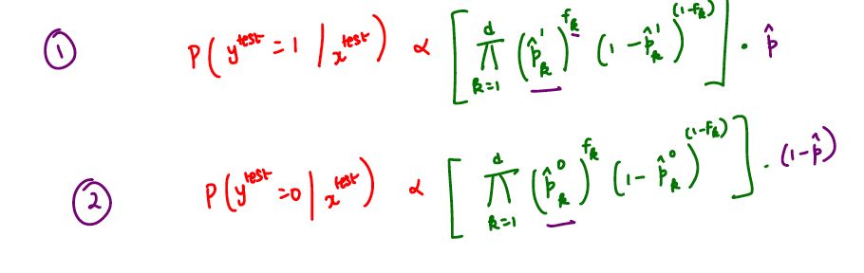
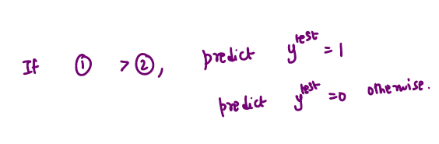

Slide 38
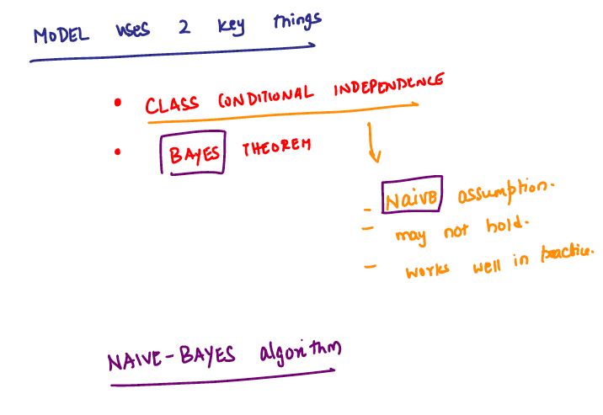

Slide 39
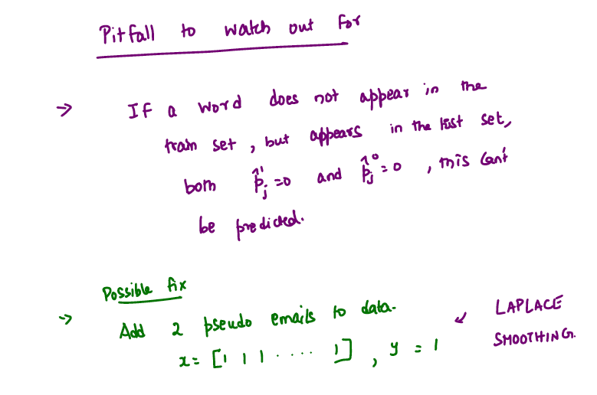


Slide 40
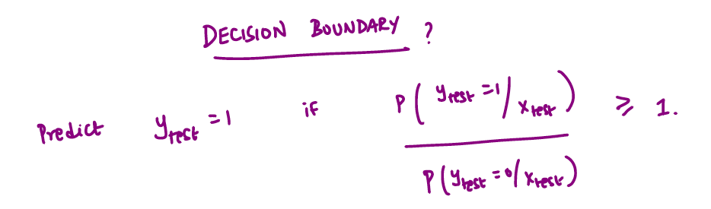
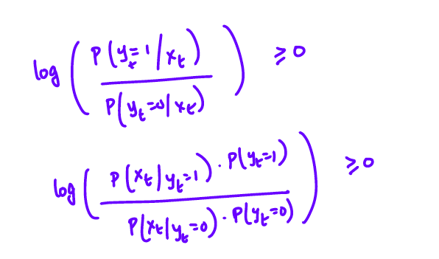

Slide 41
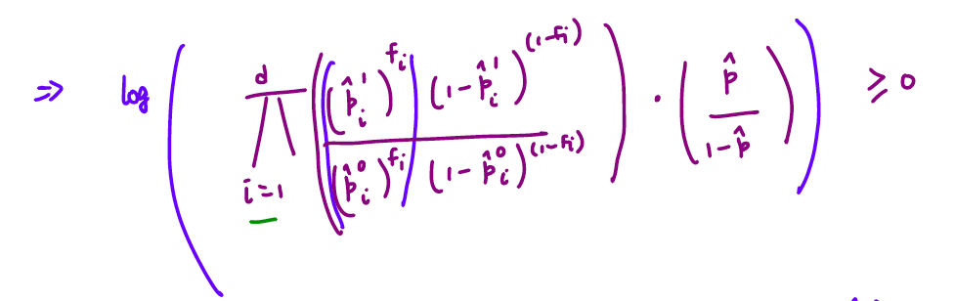
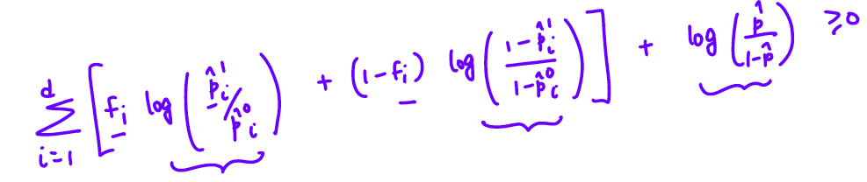

Slide 42
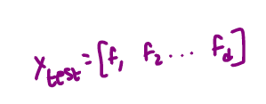
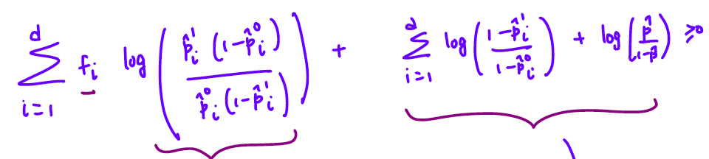

Predict 1 if

Slide 43
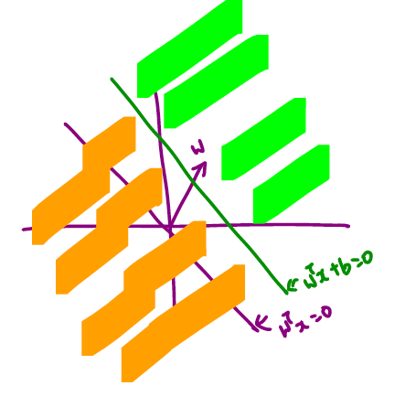

Slide 44
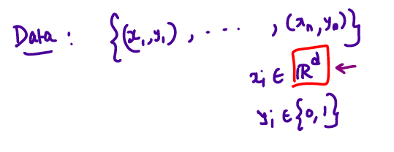
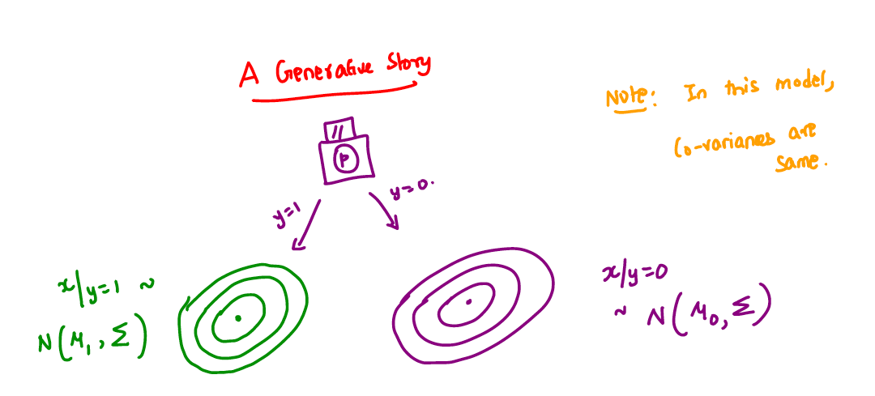

Slide 45
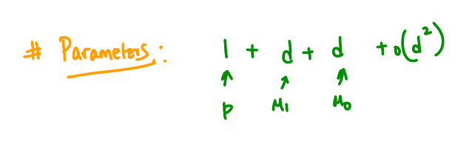
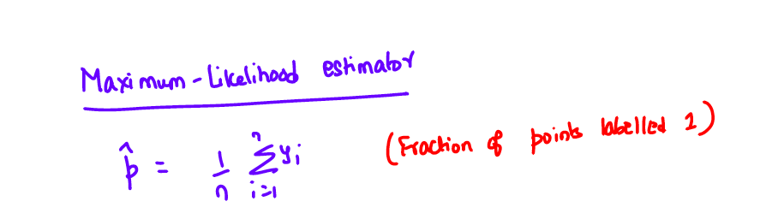


Slide 46




Slide 47



Slide 48


Slide 49


Slide 50


Slide 52


Slide 53


Slide 54
















Slide 55










We know in general the problem of finding best w is NP-hard.
But is it still hard under linear separability assumption?

Slide 56



PERCEPTRON
Frank Rosenblatt ’50, Ph.D. ’56, works on the “perceptron” –
what he described as the first machine “capable of having an original idea.”
https://news.cornell.edu/stories/2019/09/professors-perceptron-paved-way-ai-60-years-too-soon

Slide 57






















PERCEPTRON - ALGORITHM

Slide 58



























Slide 59
1
-1
Fixing one error
might lead to
more errors elsewhere

Slide 60
In general, does perceptron work for linearly separable data?
Recall
label = 1
[0,-1]
Is this
a
linearly
separable
dataset?
label = -1
[-1,0.5]
[0,1]

Slide 61
label = 1
[0,-1]
label = -1
[-1,0.5]
[0,1]
Any w in the positive x-axis linearly separates the data.
The dataset is linearly separable.
Let’s see what perceptron learns from this data!

Slide 62
label = 1
[0,1]
label = -1
[-1,0.5]
[0,-1]
 | Predicted label | True label
[0 1] | 1 | 1
[0 -1] | 1 | 1
[-1 0.5] | 1 | -1
w⁰ = [0 0]

Slide 63
label = 1
[0,1]
label = -1
[-1,0.5]
[0,-1]
 | Predicted label | True label
[0 1] | -1 | 1
[0 -1] | 1 | 1
[-1 0.5] | -1 | -1
w¹= [1 -0.5]

Slide 64
label = 1
[0,1]
label = -1
[-1,0.5]
[0,-1]
 | Predicted label | True label
[0 1] | 1 | 1
[0 -1] | -1 | 1
[-1 0.5] | -1 | -1
w²= [1 0.5]

Slide 65
label = 1
[0,1]
label = -1
[-1,0.5]
[0,-1]
PERCEPTRON DOES NOT CONVERGE
 | Predicted label | True label
[0 1] | -1 | 1
[0 -1] | 1 | 1
[-1 0.5] | -1 | -1
w³= [1 -0.5]

Slide 66












Slide 67









Slide 68










Slide 69













Slide 70












Slide 71
















Slide 72














Slide 73









Slide 74











Slide 75













Slide 76

















Slide 77







